Slide 1
How Members and Casual Riders Use Cyclistic Differently
Cyclistic Bike-Share Capstone Analysis
Created by: Weibin Liu

Slide 2
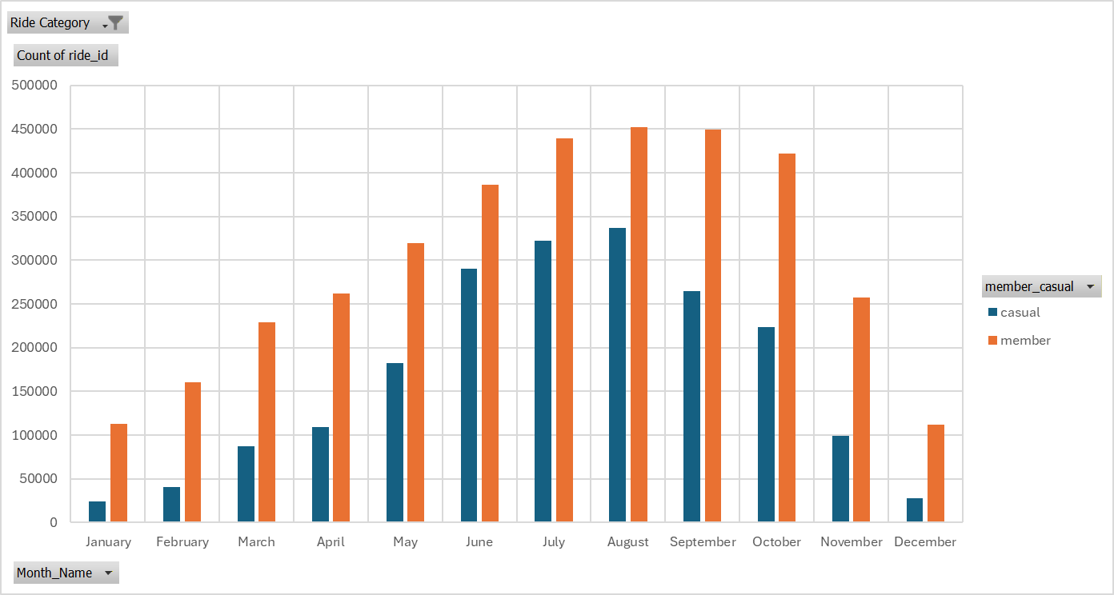
Riders are highly seasonal
Casual riders show strong seasonality: usage peaks in summer and drops sharply in winter
Members share similar patterns with Casual riders
Both Casual riders and Members use our service less during the colder months, as it is too cold to comfortably ride a bike.

Slide 3
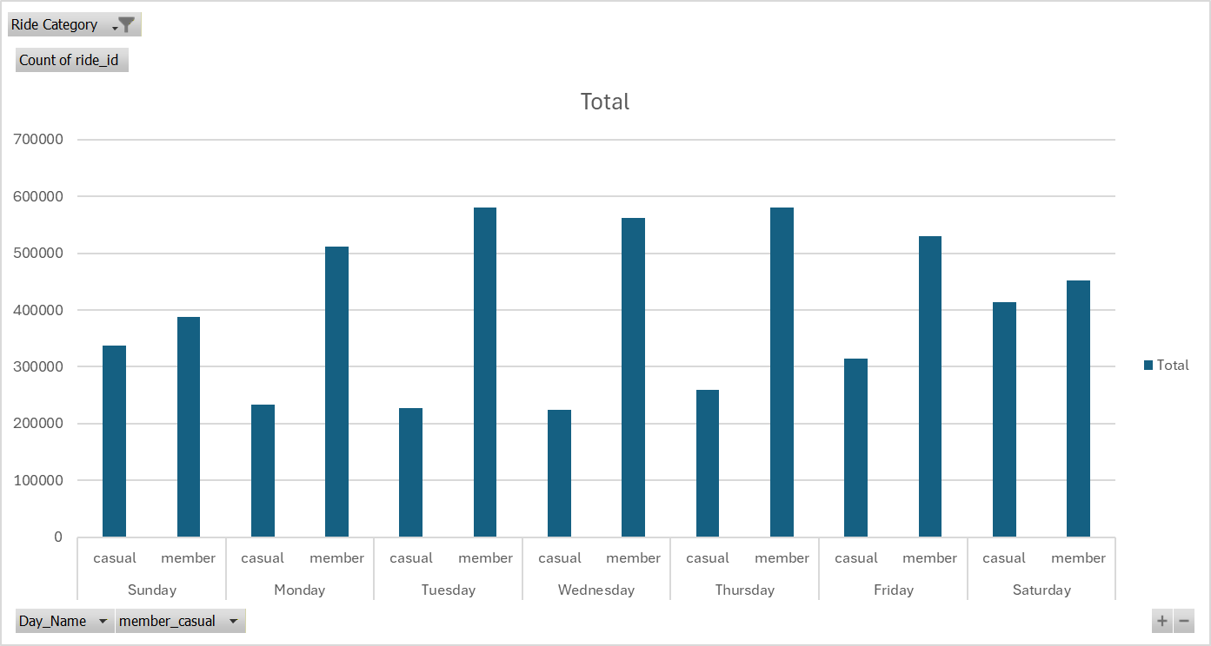
Casual Riders Peak on Weekends — Members Ride Most During the Work Week
Casual riders concentrate rides on weekends (Saturday is their busiest day)
Members ride most during the work week (highest on Thursday and Tuesday)
Members provide steady, reliable usage all week — casual riders are much more weekend-focused

Slide 4
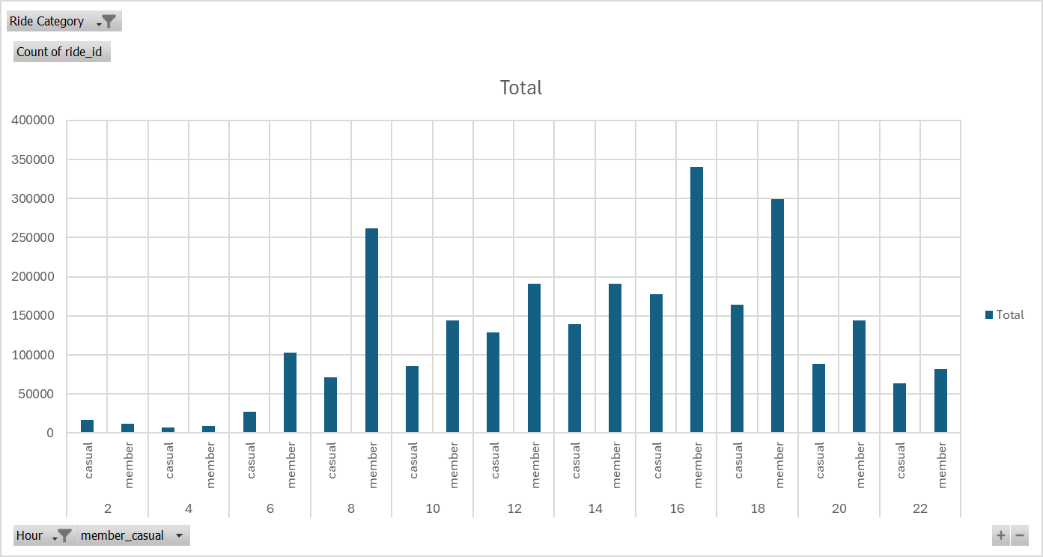
Members Ride at Peak Commute Hours — Casuals Ride More Leisurely Throughout the Day
Members show clear commute spikes: highest usage around 8 AM and 4–6 PM
Casual riders have a steadier, more leisurely pattern that builds through the afternoon and drops off around sunset
This timing difference reinforces that members use bikes for practical transportation while casuals use them for recreation
Members concentrate rides during typical work commute windows, where casual riders spread rides more evenly across daylight hours, peaking in the afternoon.

Slide 5
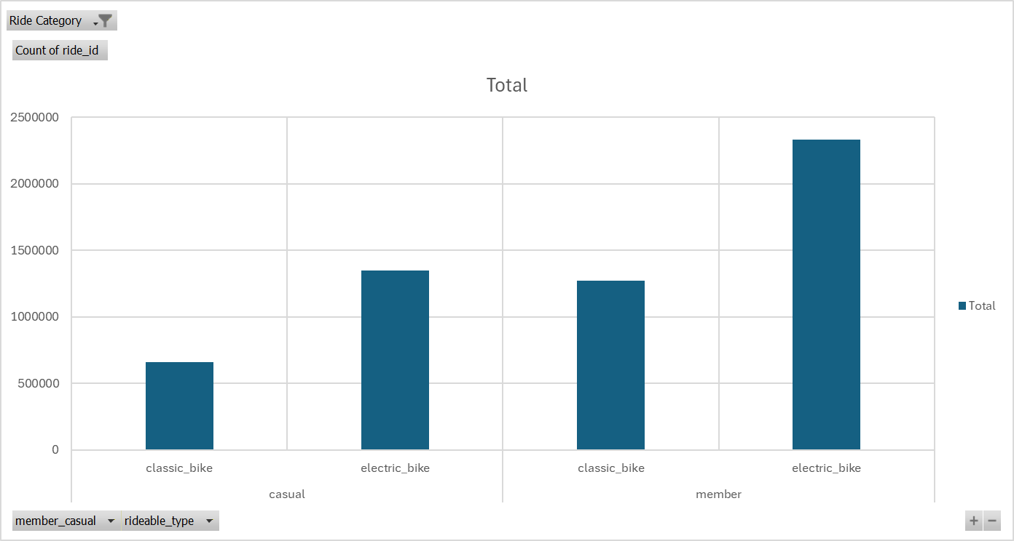
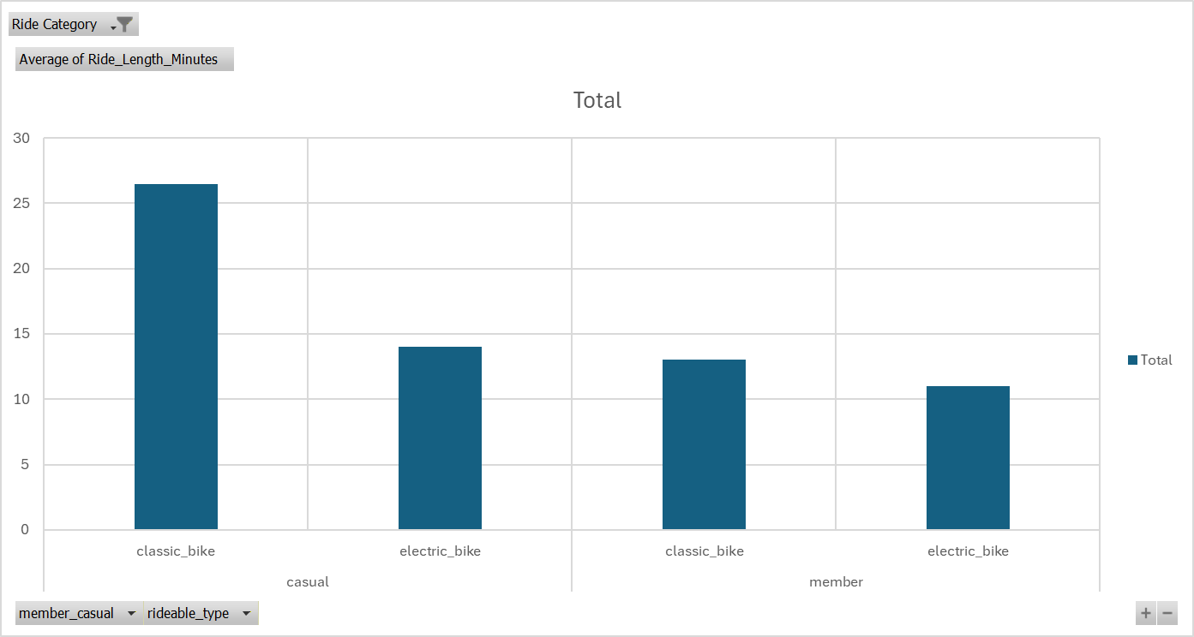
Both Groups Prefer Electric Bikes — But Casuals Ride Classic Bikes Much Longer
Both casual riders and annual members strongly prefer electric bikes
Casual riders take significantly longer rides on classic bikes compared to electric bikes
Members show the same pattern, but the difference is much smaller
Casual riders average 24+ on cassic bikes vs only 13 minutes on electric bikes. This suggests casual riders enjoy the classic bike experience more (leisure rides), while members are more efficiency-focused regardless of bike type.

Slide 6
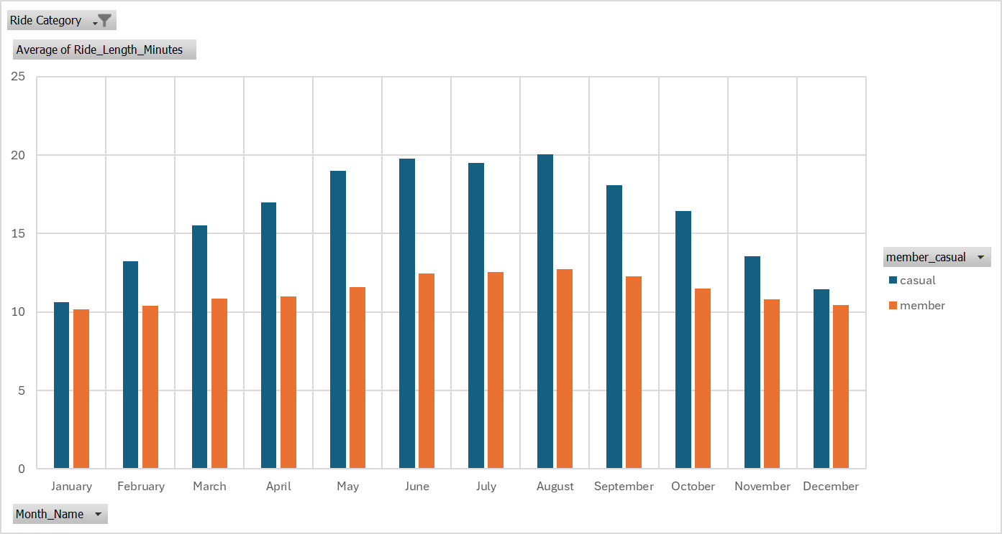
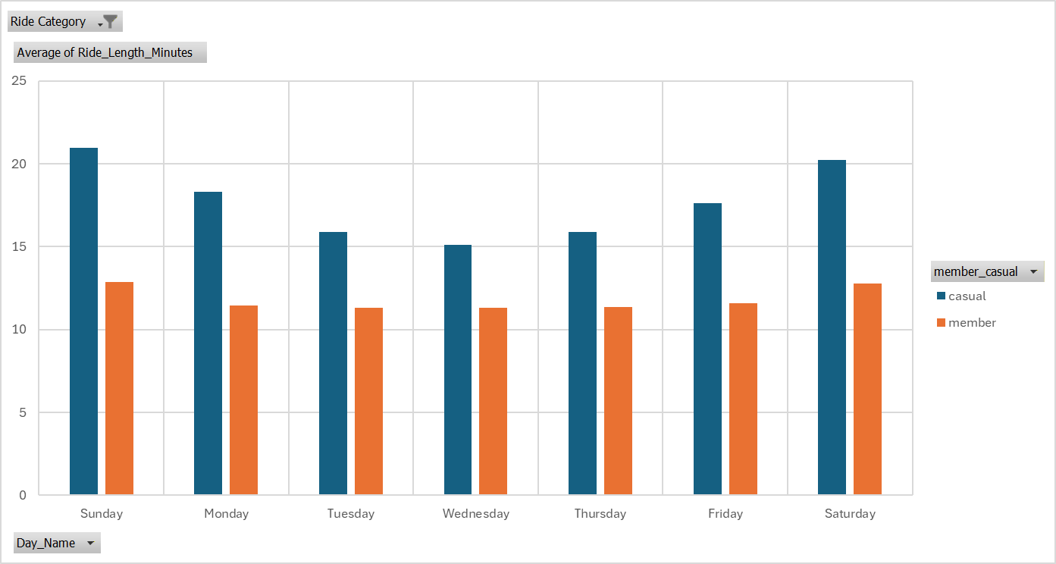
Casual Riders Take Significantly Longer Rides — Especially in Summer and on Weekends
Casual riders average 17.72 minutes per ride vs members’ 11.82 minutes
Casual ride length increases sharply in warmer months and peaks in August
Members keep ride times much more consistent year-round and throughout the week
Casual riders treat bikes as leisure — longer rides on weekends and during summer.
Members treat bikes as transportation — shorter, steady rides all year.

Slide 7
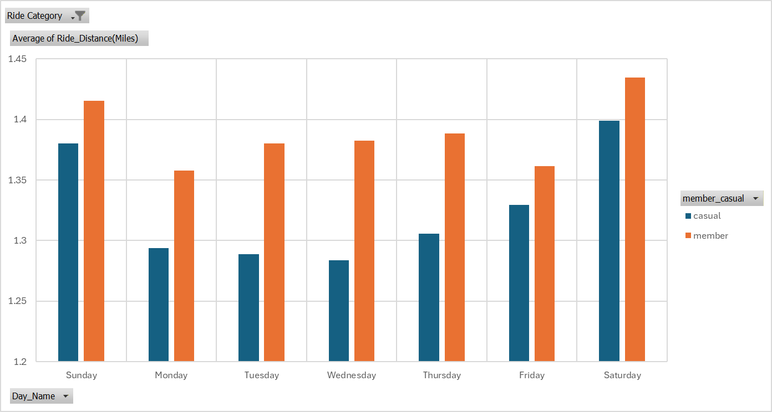
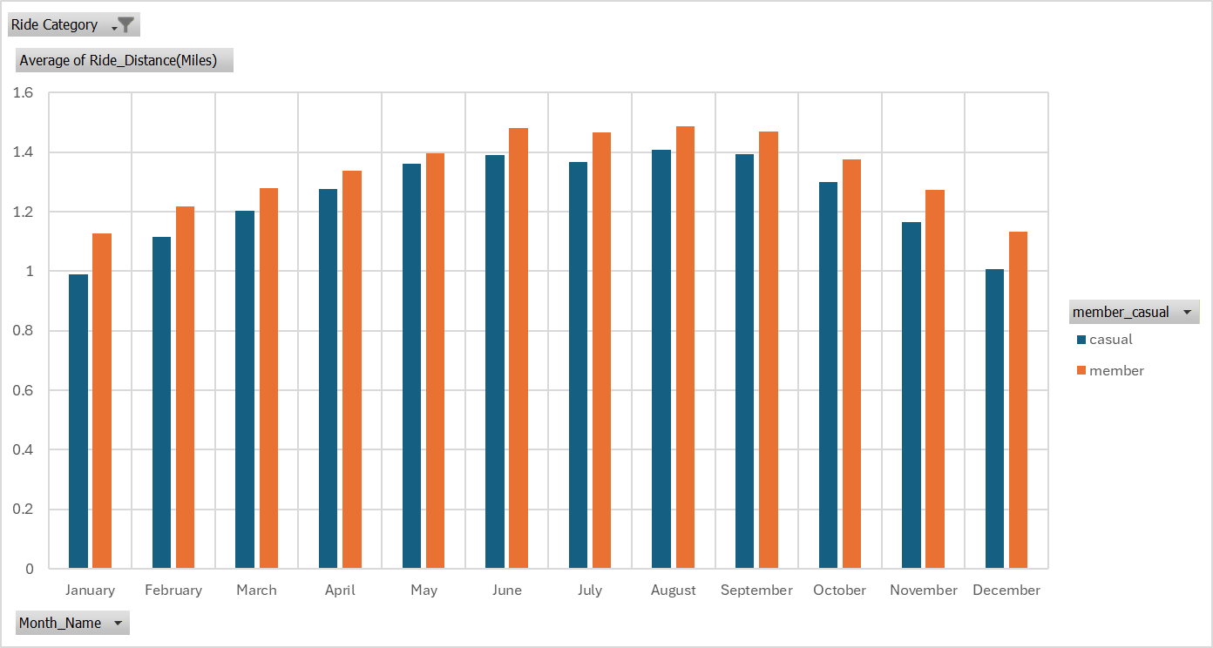
Ride Distance Is Almost Identical — Members Go Slightly Farther
Members ride slightly longer distances on average (1.39 miles) than casual riders (1.33 miles)
Both groups ride farther on weekends, especially Saturday
Distance for both rider types gradually increases through summer and peaks in August, then declines in the fall and winter
While distance traveled is very similar between casual riders and members, the small difference reinforces that members use the bikes more efficiently for transportation. The strong summer peak shows weather still plays a big role for both groups.

Slide 8
Final Conclusion
Annual members and casual riders use Cyclistic bikes in fundamentally different ways.
Casual riders treat the service as weekend leisure and seasonal fun (longer rides, big summer peaks)
Members treat it as reliable daily transportation (shorter rides, consistent year-round and weekday usage)
Distance traveled is almost identical — the real difference is how long they keep the bike
Understanding these patterns gives us a clear opportunity to convert casual riders into loyal, high-value annual members — the key to Cyclistic’s long-term growth.

Slide 9
Top Three Recommendations to turn Casuals Into Members
Leisure to Members Promotion
Run a promotion for Casual riders who take rides longer than 20 minutes on Friday through sunday, where they can get annual membership with an 20 discount for the first month. This targets the high amount of casual riders who use our service mainly on weekends.
Events during the July - August
Host targeted community events during peak casual months (especially July and August). Use these events to give casual riders a “final push” toward membership by creating a sense of community and belonging. This also allows us to foster a stronger community relationship with our current members creating consumer loyalty.
Winter Amenities for Members
Offer free winter amenities (hot drinks, mittens, scarves) at docking stations for annual members and anyone who upgrades during the colder months.Both groups see a sharp drop in usage during winter, but members stay far more consistent. These perks give casual riders a reason to commit year-round instead of switching to other transport options

